Slide 1
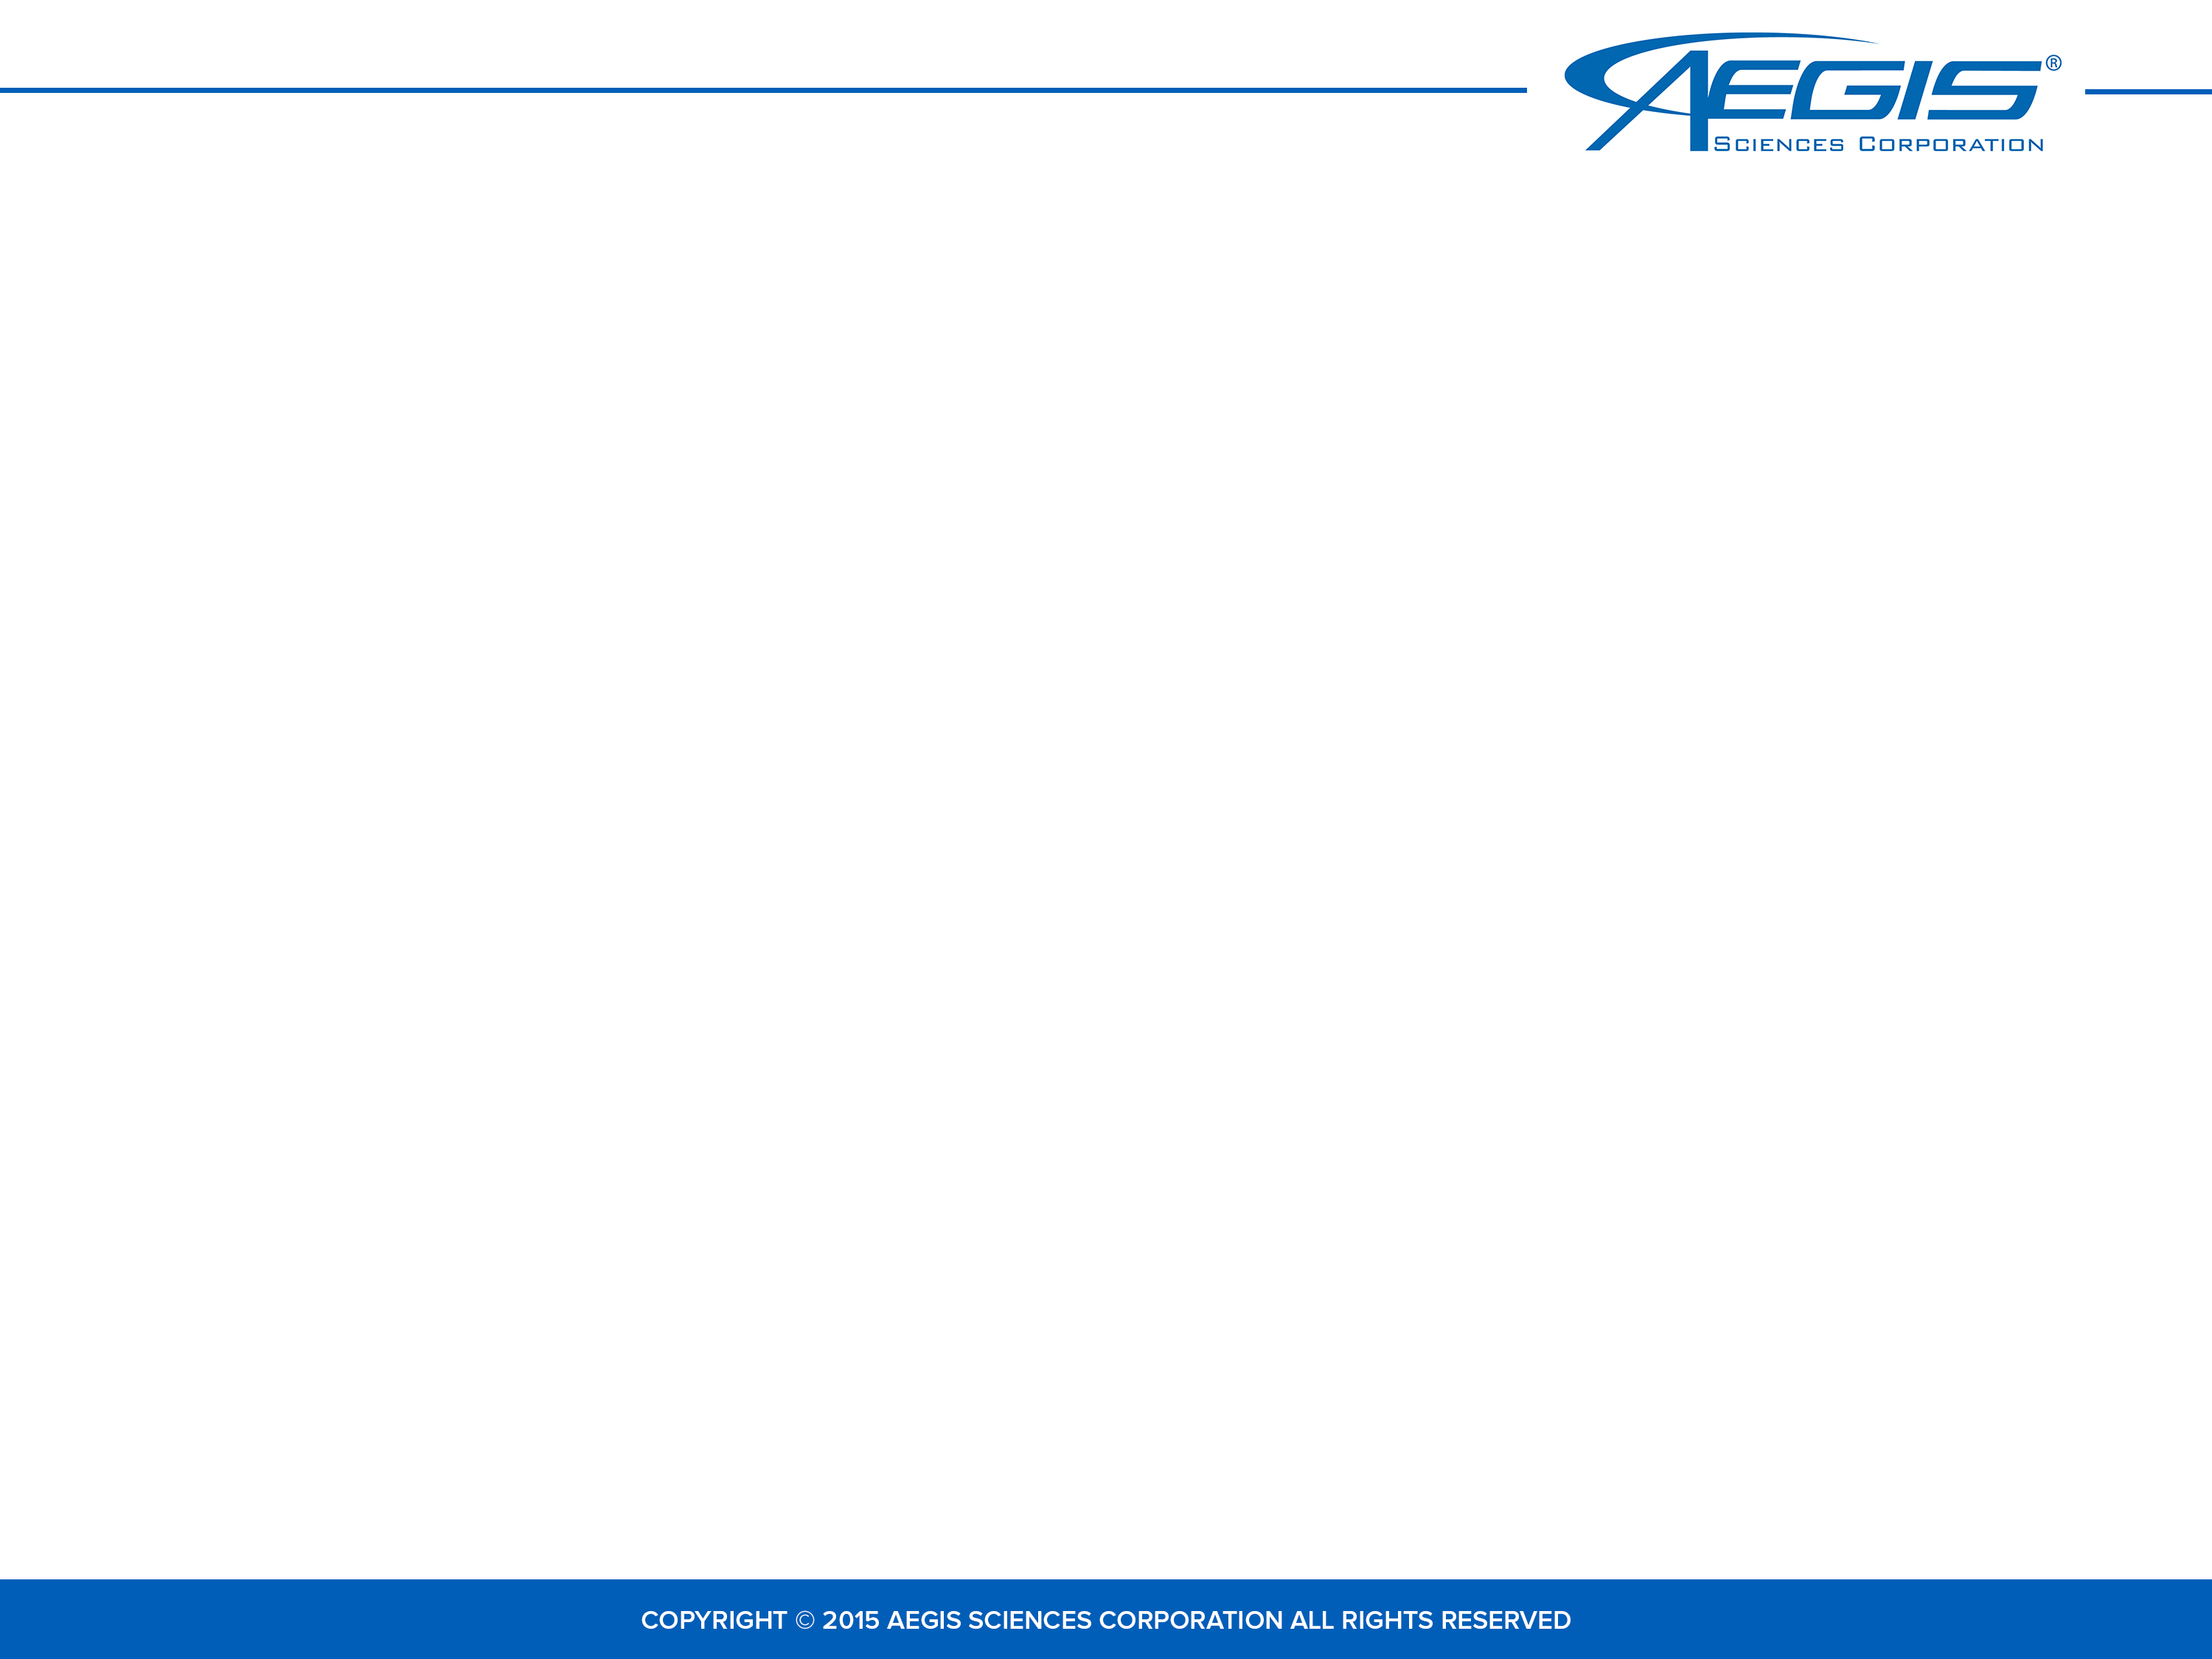


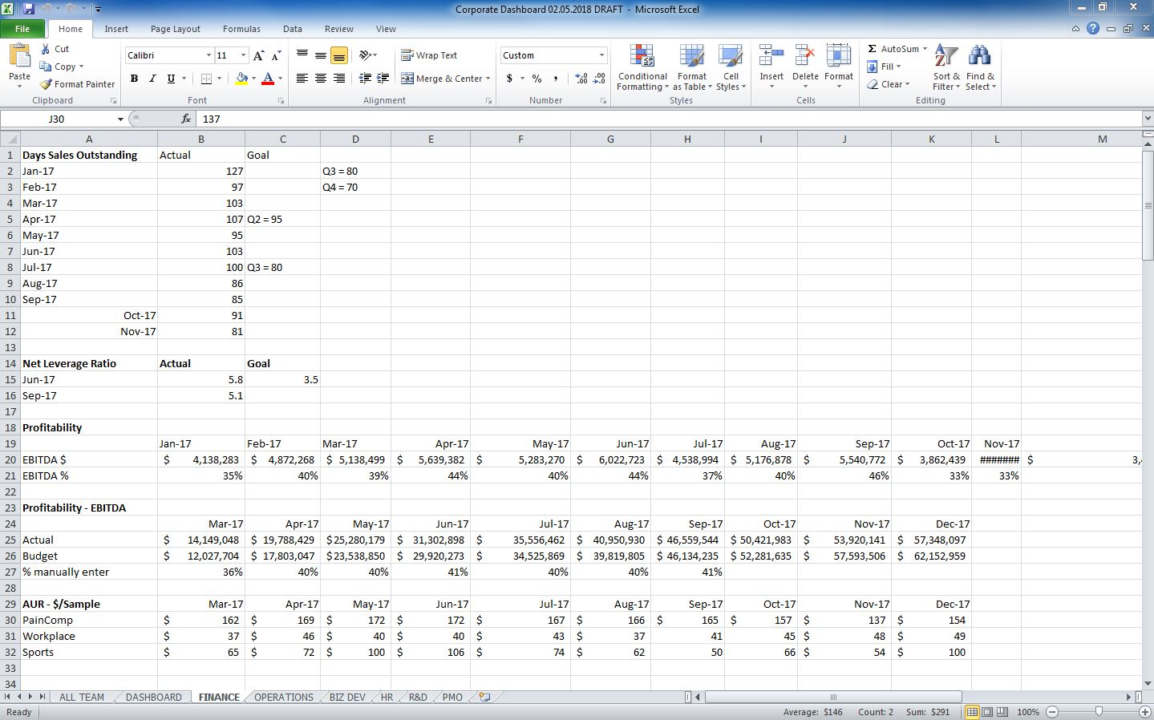
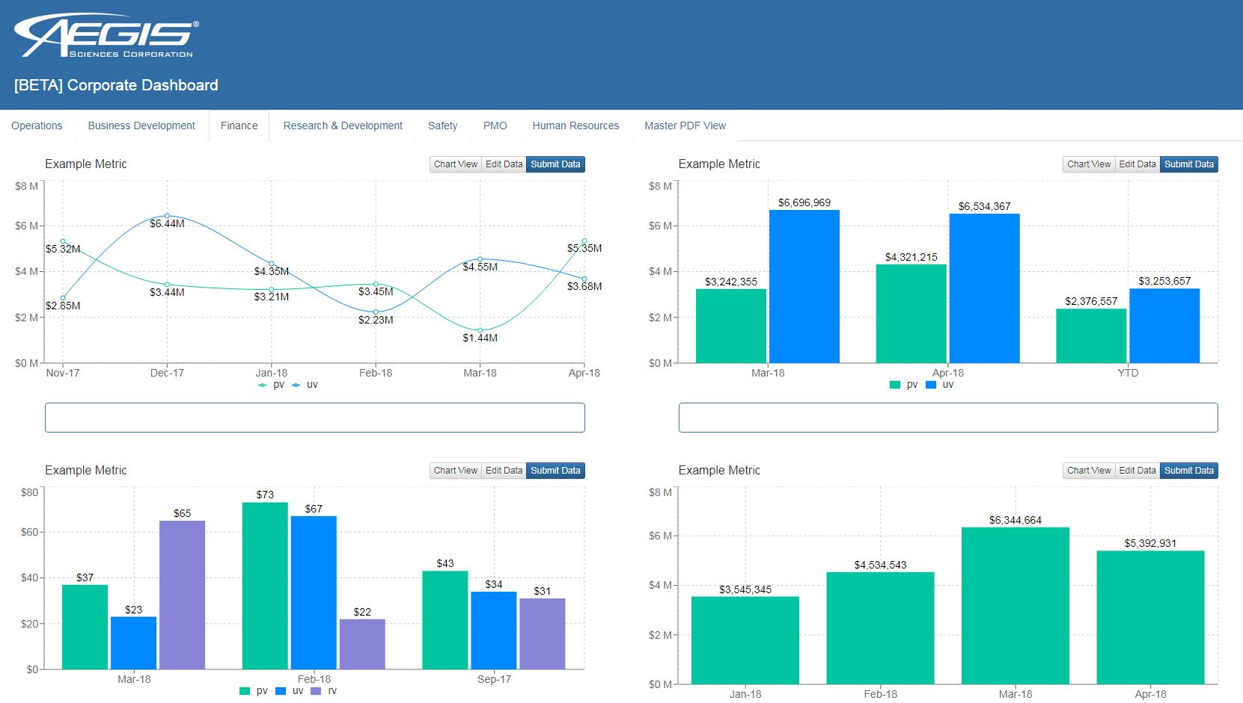



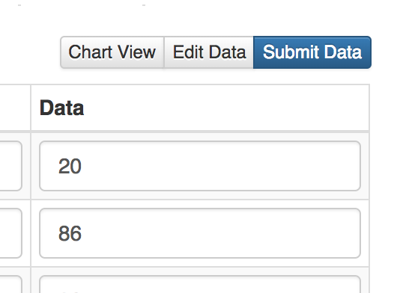
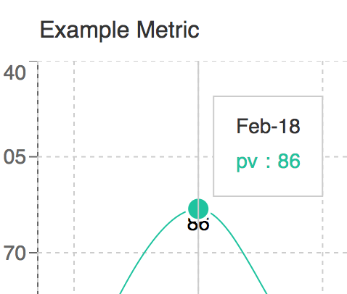









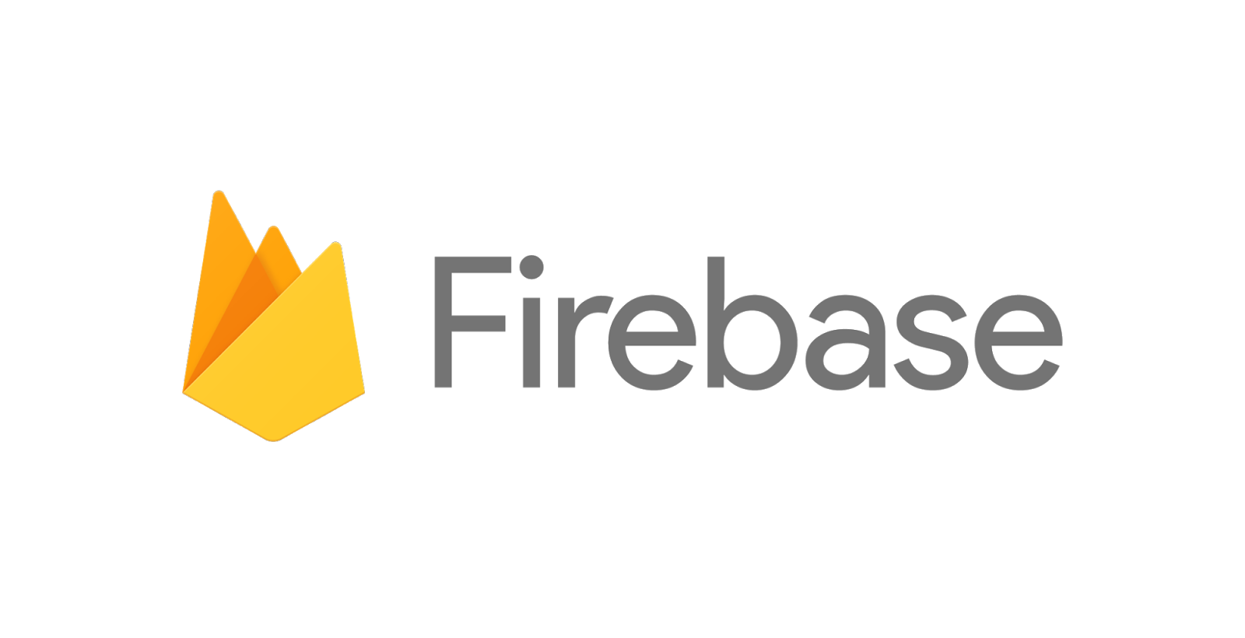


Corporate Dashboard Application
Chris Acciai, Computer Science and Economics at the University of Virginia
Abstract
Old System
New System
In any complex and evolving company such as Aegis, data must be constantly utilized and monitored in order to gain valuable insights into the health and direction of the company. The data Aegis generates in itself is inutile, but when analyzed and presented in a cohesive visual manner it allows the viewer to see trends, outliers, and other key values regarding the company’s performance. A corporate dashboard serves the purpose of presenting those key metrics in a clean, neat, and thoughtful way in order to give executives better insight and help educate decision-making.
Aegis’s current dashboard however is outdated and hindered by the fact that it is an excel file; which is complex and static by nature. The solution was to create a online real-time application that adds both simplicity and functionality to the dashboard.
Static excel file
Data was scattered
and non-intuitive
Not interactive
Only one user can update
User friendly
Added functionality
Web-based
Real-time data
Key Features
Users can edit data and view live changes in charts
SQL database integration
User authentication
Direct queries to data source
Additional metrics
Challenges to Address
One click downloads the entire dashboard as a PDF for easy printing
Interactive charts show tooltips on mouse roll-over
Static File
The current static file only allows a single editor and must be printed each time someone needs to view the document.
Framework
Next Steps
Front-end
Back-end
Tedious Updates
I utilized ReactJS to design the front-end interface of my application. Each chart is pulled from the Recharts charting library API that is built on React components.
For current beta purposes, the application’s backend is supported by Google’s firebase. This allows easy database storage and access.
Each data set is spread out over multiple excel files which makes updating the dashboard confusing and time-consuming.
VS
Acknowledgements
User functionality
I want to thank my mentor Jeff Rossini as well as the rest of the marketing team for an overall great experience as an intern. I would also like to thank Rob Case and his team for giving me advice and guidance through the application development process. Lastly a huge thank you to Darcie Duckworth for the incredible effort and selflessness in managing this internship program at Aegis.
The current system doesn’t support any interaction with the data. Furthermore it lacks an easy structure for navigation.
8

